Slide 1

David Liu, Ph.D.
Founder, CEO
mindgpa@gmail.com
liud@pfw.edu

Slide 2
According to the American Test Anxiety Association, about one in five students have high test anxiety which impairs their academic performance.
MindGPA’s mobile app will help each student find their own customized way to have better mental health and grades. It will offer 24/7 resources, and can be accessed any place, privately, and with social components. MindGPA, with AI inside, guides, protects, and advocates for students’ well-being and academic success.
It is supported by both classical and quantum machine learning.

Slide 3
This all sounds wonderful. Thank you so much for dedicating time toward helping in this area. I can tell you there is a tremendous need for a whole range of services.
--- TRIO Director --

Slide 4


Slide 5
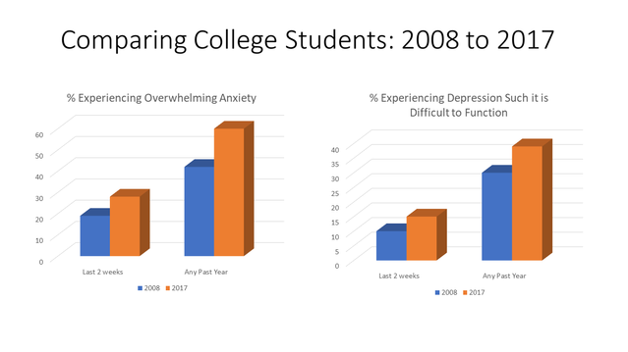
https://www.psychologytoday.com/us/blog/theory-knowledge/201811/the-college-student-mental-health-crisis-update

Slide 6
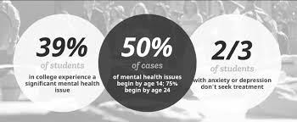
Mental Health Crisis
https://www.bu.edu/ctl/files/2019/10/Dr.-Jerry-Schultz-BU-HANDOUT.pdf

Slide 7








Slide 8
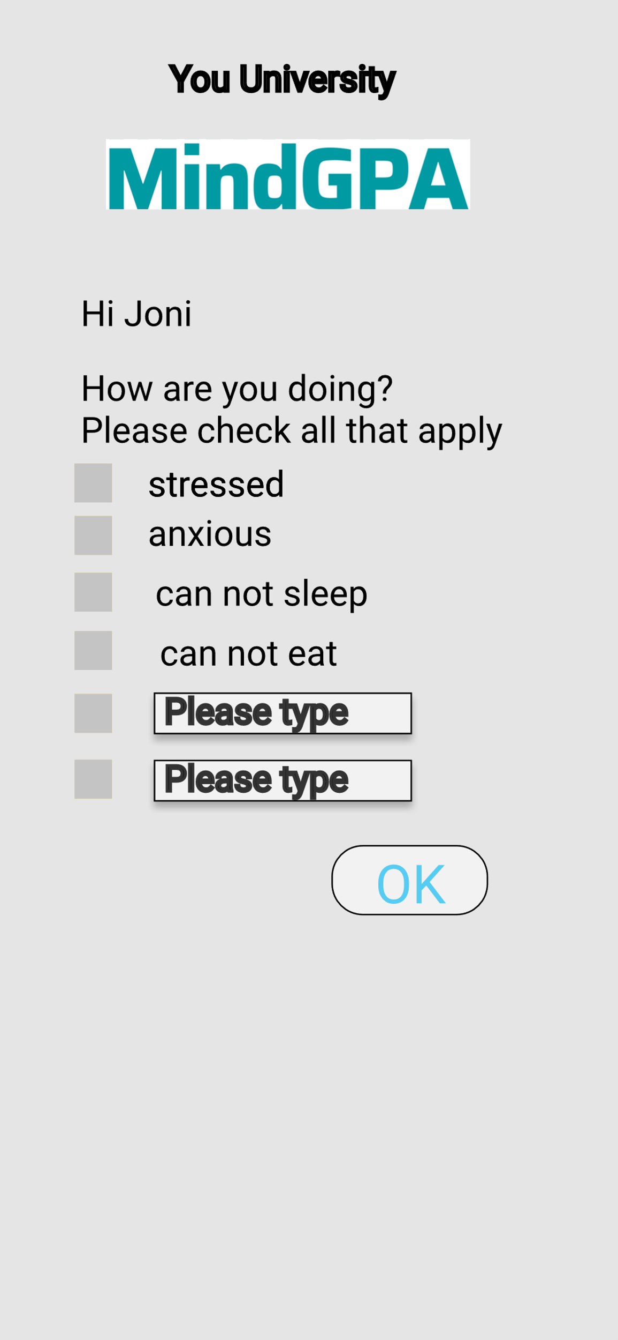
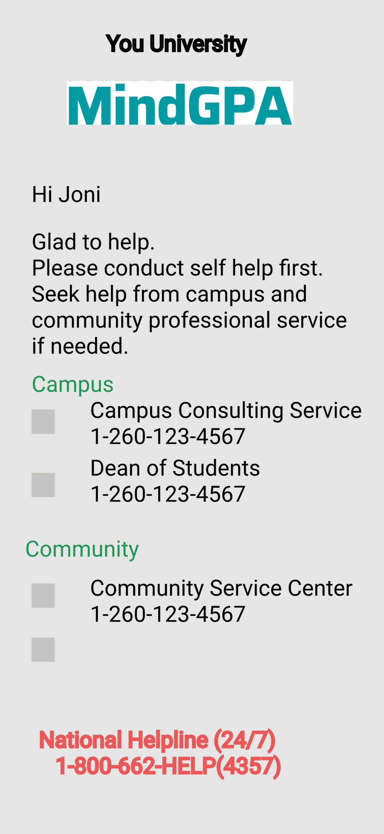

Slide 9
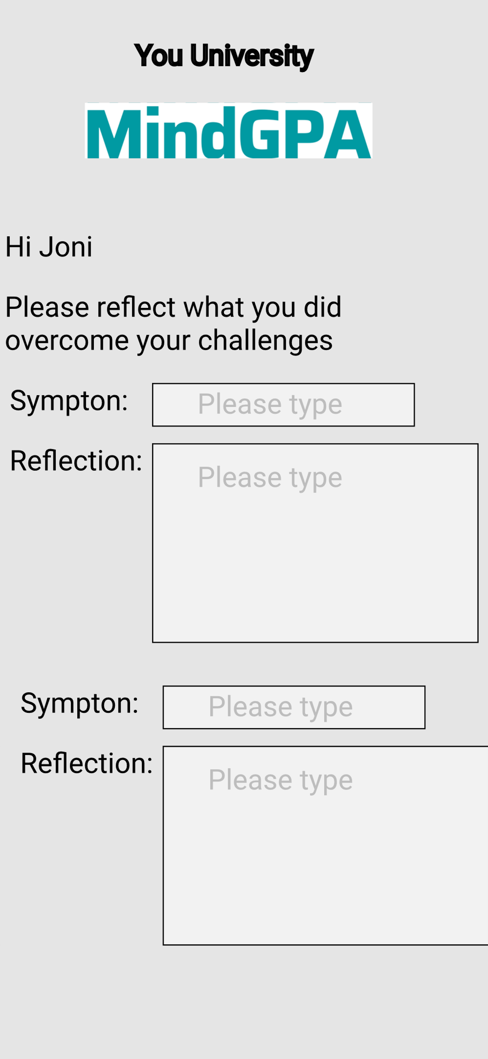

Slide 10
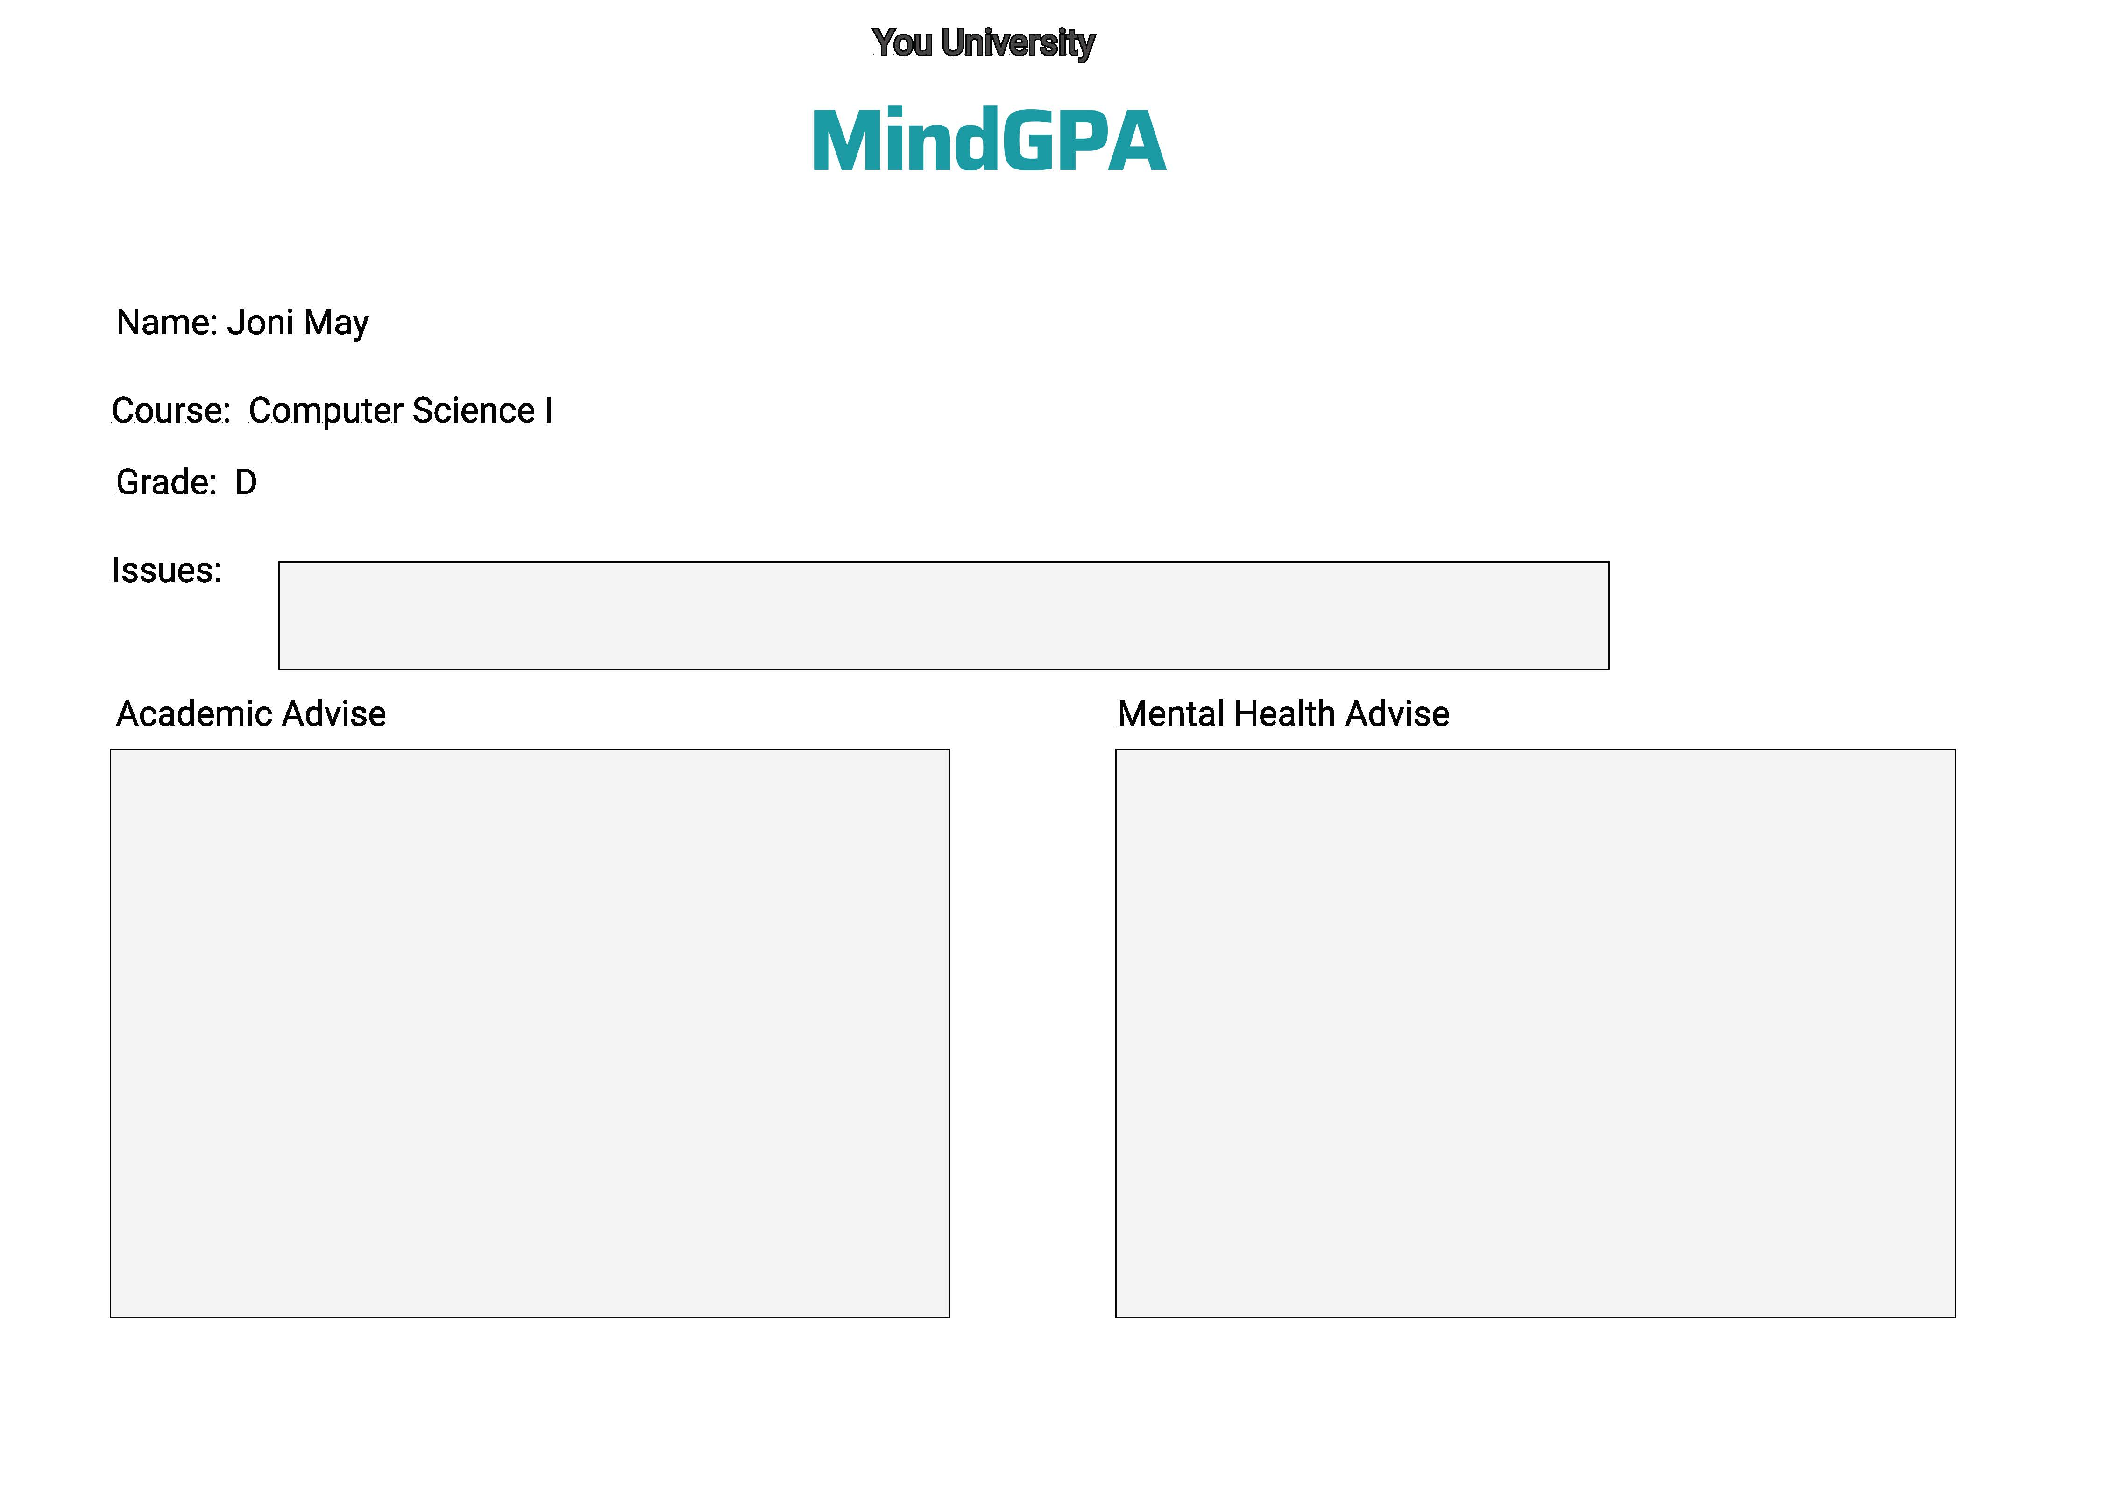

Slide 11

Traction
Survey Results:
100 % students want to use the app
100 % advisors want to use the app
Mobile App in Development
Desktop App in Development
Classical Machine Learning
Quantum Machine Learning

Slide 12

Total Addressable Market
Indiana: $20 M
Great Lakes: $135 M
US: $1 B
United States
Great Lakes
Indiana
National Center for Education Statistics

Slide 13
Competition Matrix
 | MindGPA | YouAtCollege | WellTrack
User Friendly
Privacy
Mental Health |  |  | O
Academic Success | O
Social Network |  | O
AI | O
Comprehensive |  | O
Market Share |  | O
O: clear advantage;
X: no clear advantage

Slide 14

Revenue Model
Subscription | Fee Per Student
monthly | $ 5.00
Yearly | $ 60.00

Slide 15
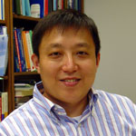
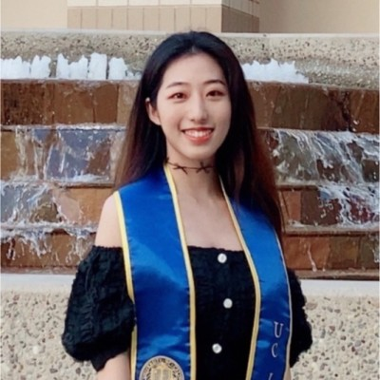


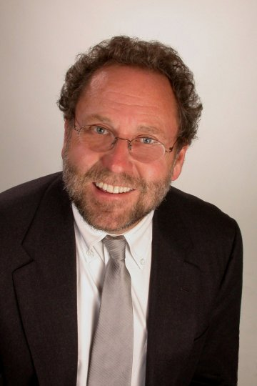
Team
David Liu, Ph.D. founder
Associate Prof. of CS
Purdue U. Fort Wayne
Software Engineer 10+ years,
major companies and startups
MHFA, QPR trained
Jiaqi Guo, ECE MS Student
Carnegie Mellon University
Yiping Wang, PhD Candidate
Applied Physics
Northwestern University
Chesley Chen, MBA. advisor
Managing Director
Life Sciences Advisory
BlumShapiro, Boston
Founders, CEOs, Digital
Health start-ups
David Young, Ph.D., advisor
Clinic Psychologist

Slide 16
Financial Overview
Startup Cost: $9, 500
Overhead: $15, 570
Gross Profit: $5/month/member
Break-even point: 3114 members

Slide 17


Ask and Introduction

Slide 18



Summary
Holistic: Mental Health & Academic Success
Guide
Protect
Advocate
https://www.mghclaycenter.org/parenting-concerns/college-mental-health-crisis-call-cultural-change-part-2/

Slide 19
David Liu, Ph.D.
Founder, CEO
mindgpa@gmail.com
liud@pfw.edu

